Slide 1
Battle of Neighborhoods
IBM Data Science Professional Certificate

Slide 2
Introduction
People need to know where to live in a new city
Information about new neighborhood
What kind of venues are nearby
Comparison with the prior neighborhood
Case Study: Person who is moving from Tecnologico, Monterrey to Austin
Need to know the best suitable neighborhood In Austin, similar to Monterrey

Slide 3
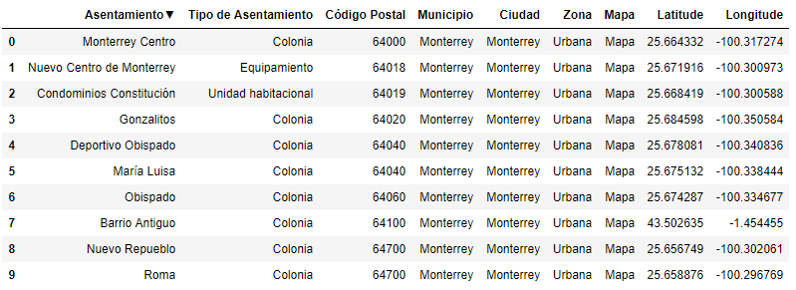
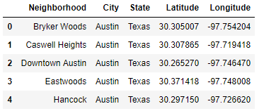
Data acquisition and cleaning
Monterrey Neighborhood data
Austin Neighborhood data
Foursquare API to extract nearby venues

Slide 4
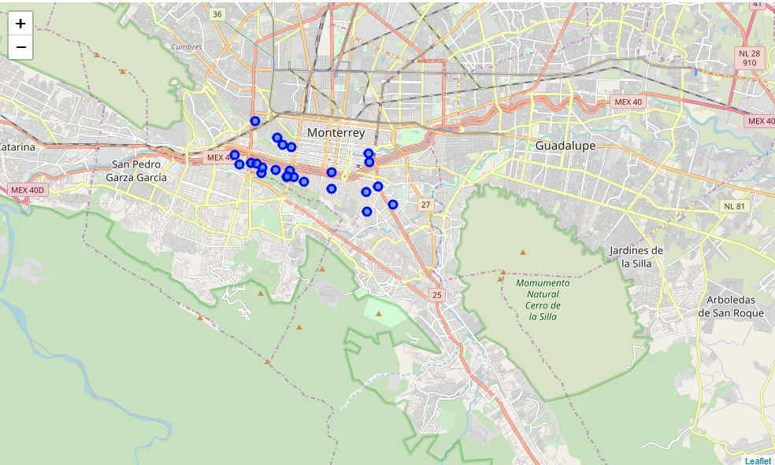
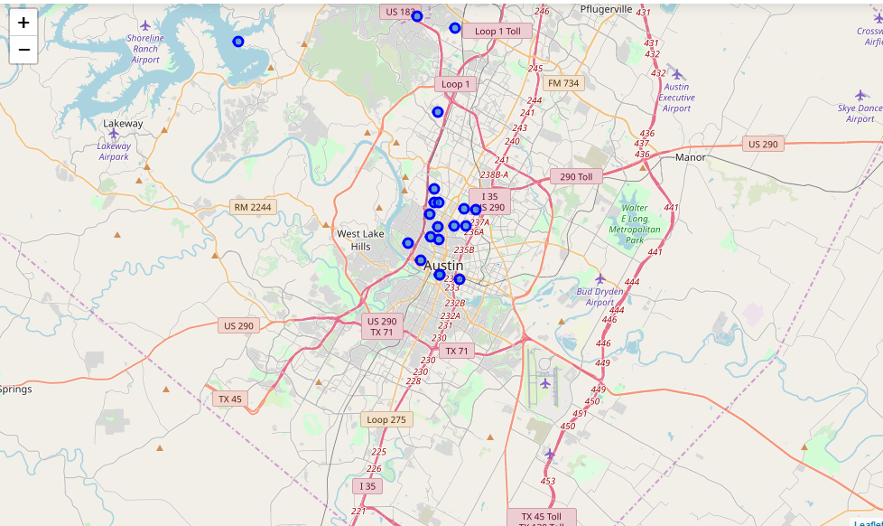
Generated Maps

Slide 5
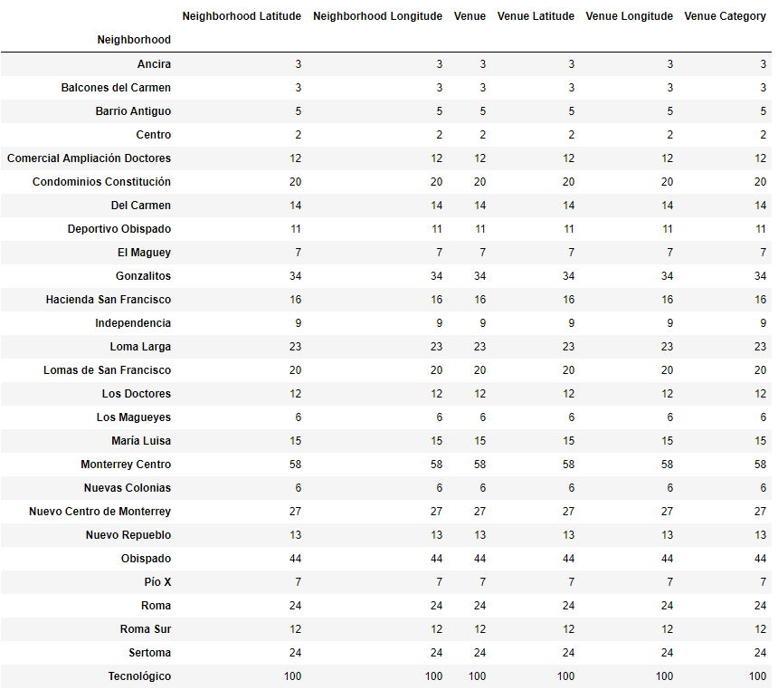
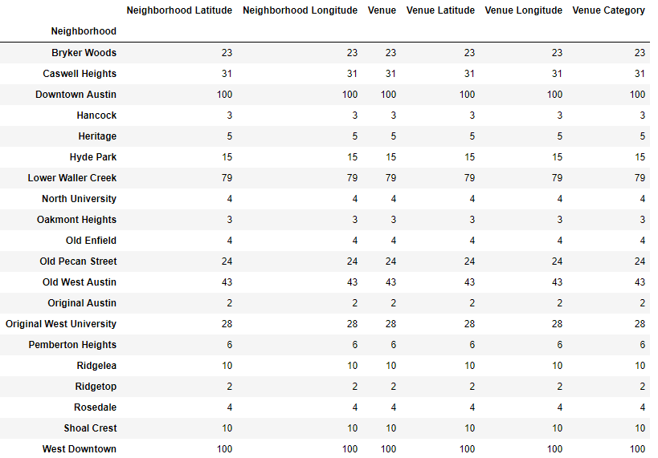
Venues nearby
Common venues nearby Monterrey and Austin

Slide 6
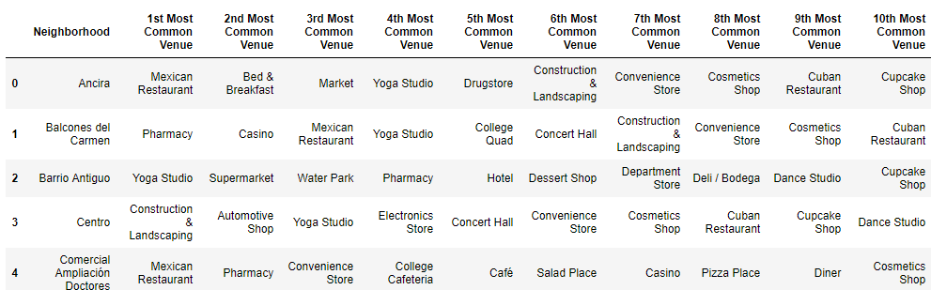
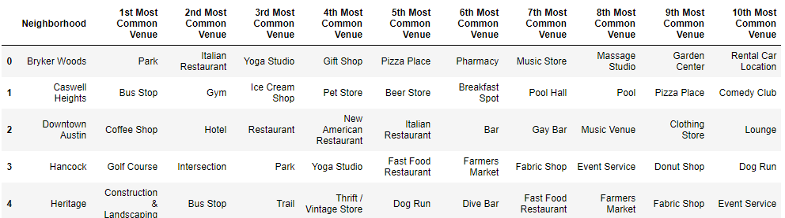
Top Venues by Neighborhood
Top venues by neighborhoods in Monterrey and Austin

Slide 7
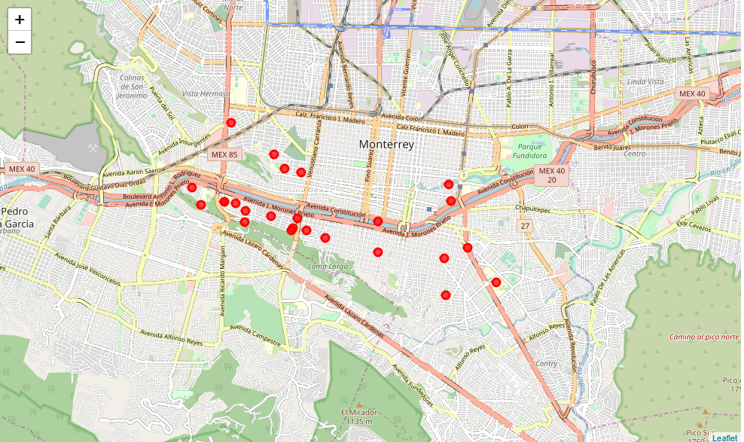
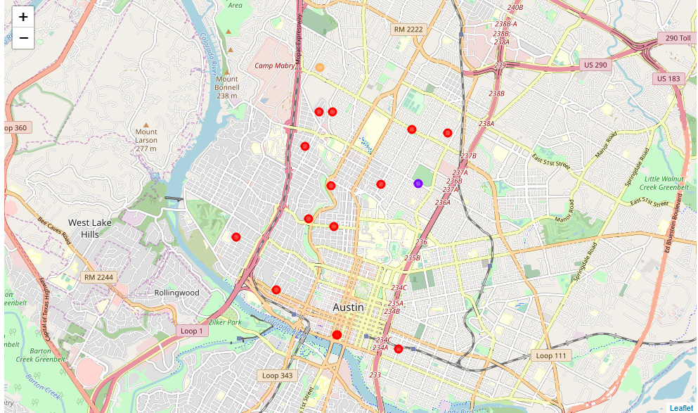
Clustering
Generated maps after clustering, for Monterrey and Austin

Slide 8
Conclusions
Tecnologico, Monterrey and Lower Waller Creek shares most of the popular venues, both are located in cluster 1
From all the other neighborhoods, the Lower Waller Creek have most coincidences
Recommendation: Check Lower Waller Creek for a place.

Slide 9
Thanks!

